Slide 1
PaGAF Secretaries Report, February 2020
Subtitle

Slide 2
Executive Committee
Dr Isaac Fordjour -President
Dr. Peter Okrah – Vice President
Isaac Amo-Kyereme - Secretary
Frederick Sarpong – Assistant Secretary
Kofi Antobam- Treasurer
Daniel Opuni-Mensah – Assistant Treasurer
Daniel Amoako- Evangelism Coordinator
Kwabena Donkor – Youth Director
Dorothy Aning – Assistant Youth Director
Ps Matthew Debrah- Ministerial Representative

Slide 3
Meetings
At least once a month (12 times since Houston leadership meeting)
At 5 emergency meetings

Slide 4
New Initiatives
Benevolence fund (increase from $6000 to $12,000)
March - Regional meeting- Bay Area, LA, Riverside, Phoenix,
December 27-29- Regional meeting- Houston, OKC, Dallas DFW, Dallas Ebenezer, Denver- Rocky mountain ( a few from LifeHouse )
Anniversary fund- 100 people giving $100 a month

Slide 5
Church Groups
Seattle
Bay Area
Los Angeles
Riverside
Phoenix
Denver
Dallas
Houston
Oklahoma city
Fresno

Slide 6
Committees
Financial
Education
Constitution
Media
Prayer
Retreat Planning
Music
Benevolence
Liaison
Youth
Evangelism

Slide 7
Baby Dedications
Houston - 2

Slide 8
Deaths
Mrs Elizabeth Nkrumah
Samuel Botchway

Slide 9
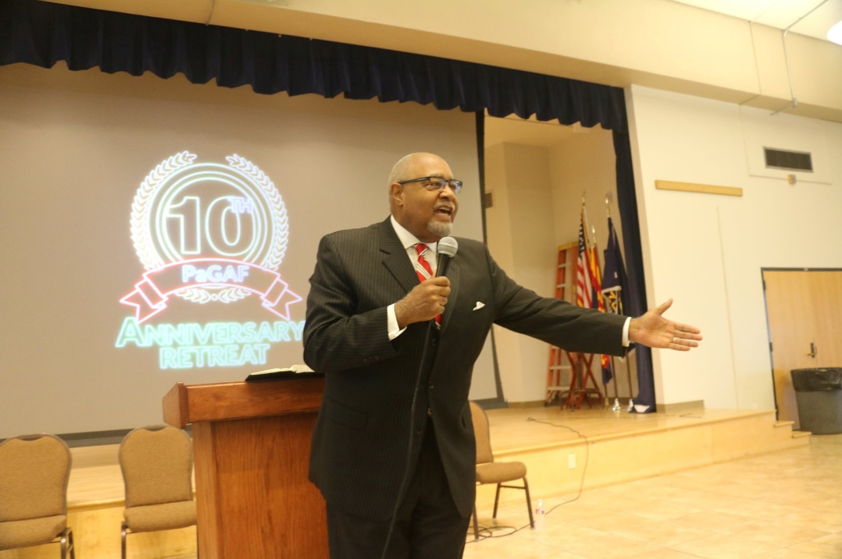
Retreat 2019
PUC president was guest speaker
Baptism
Communion service
Pastor Palmer –Arizona Conference

Slide 10
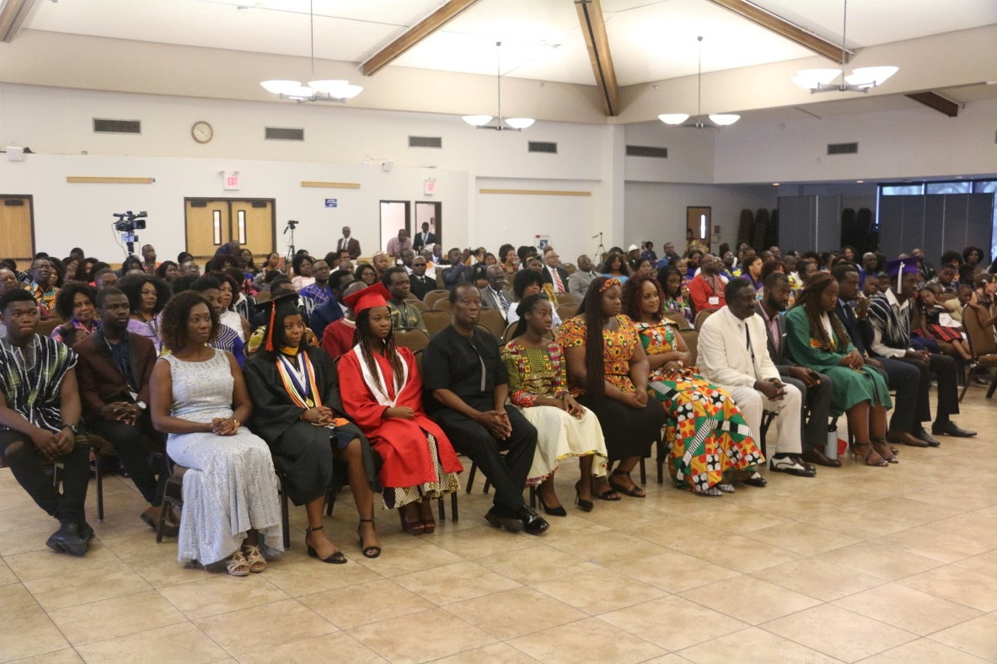
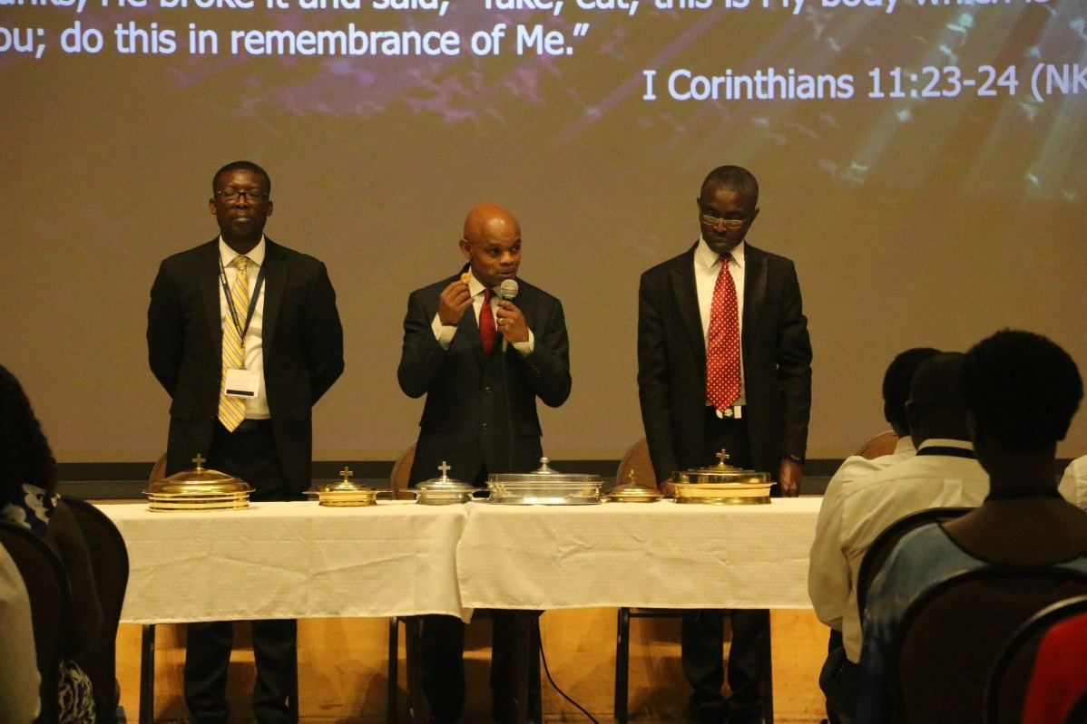
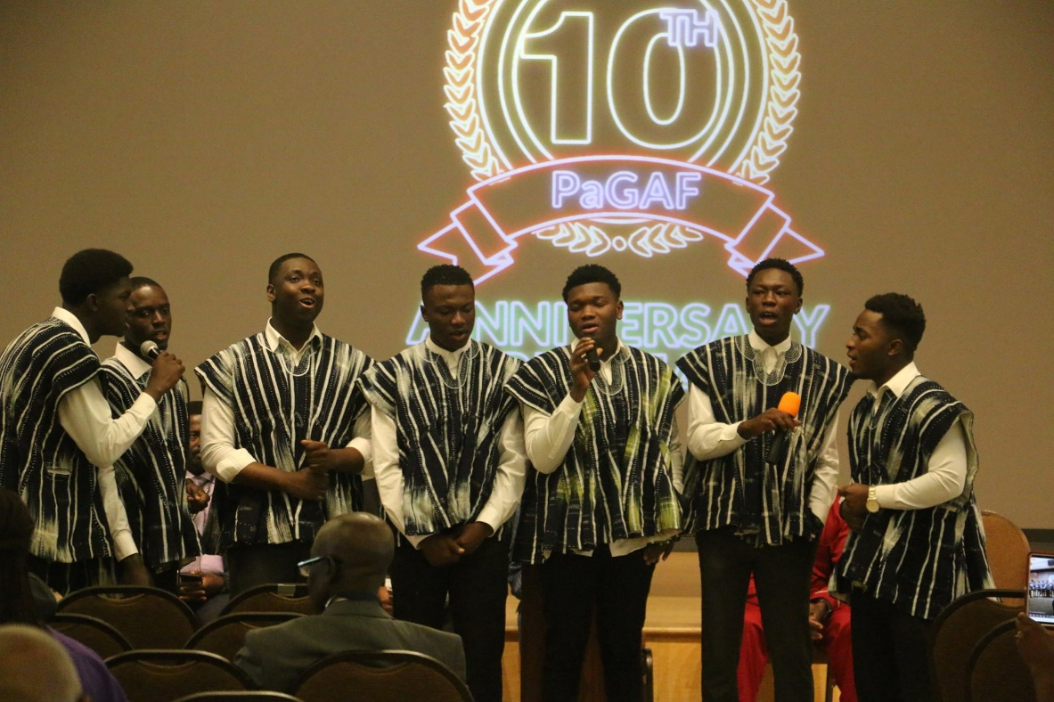
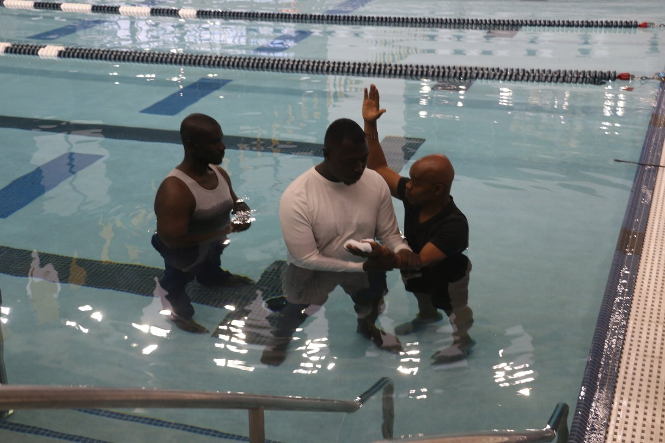

Slide 11
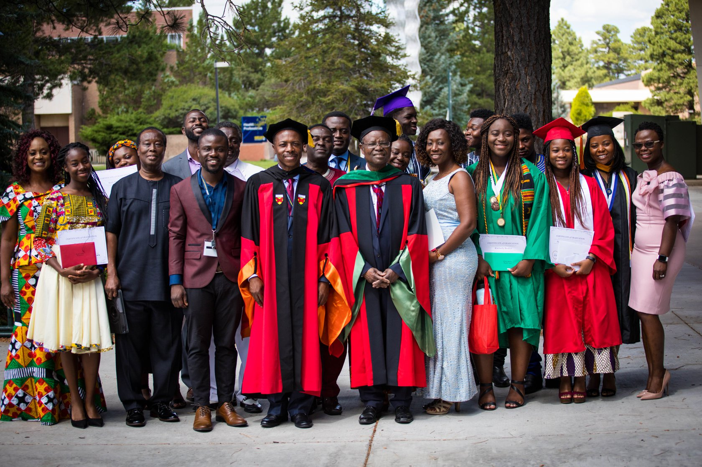

Slide 13
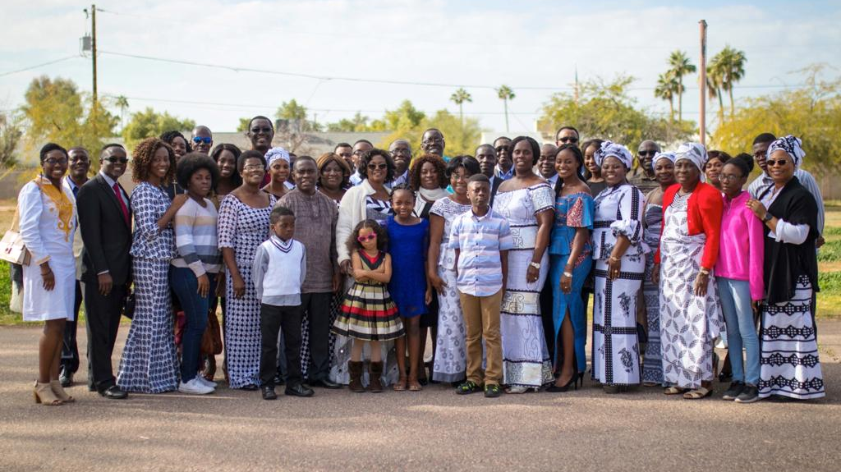
Phoenix

Slide 15
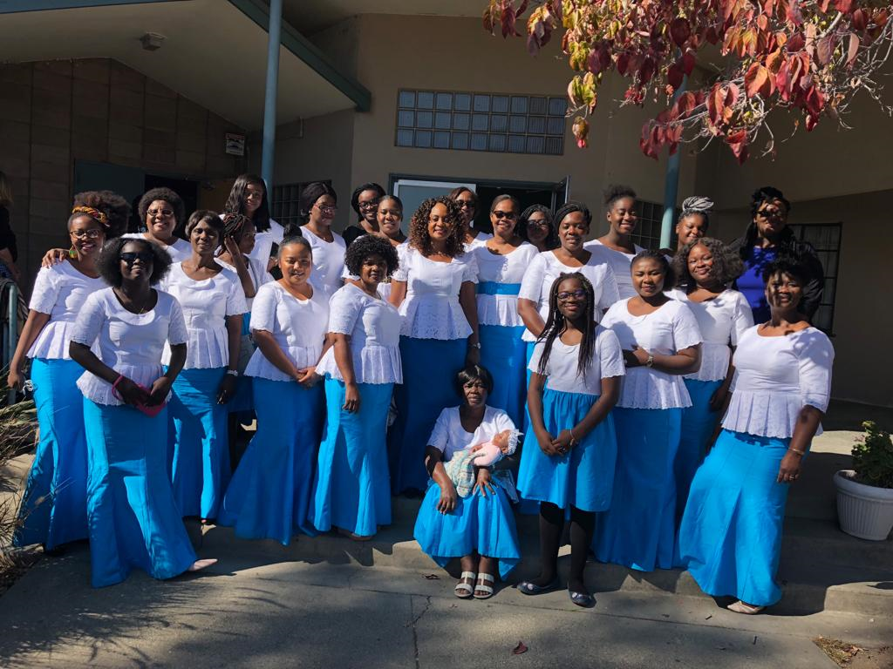
Bay Area

Slide 17
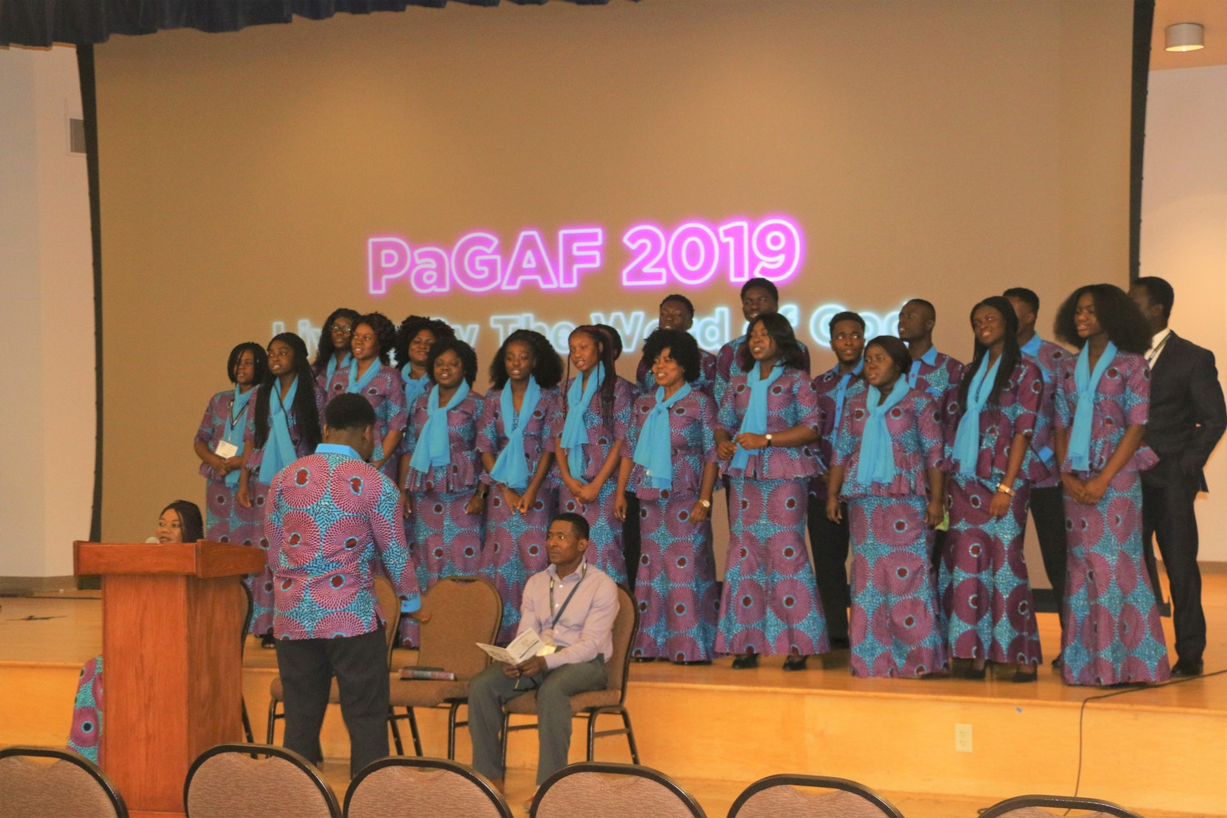
Denver

Slide 19
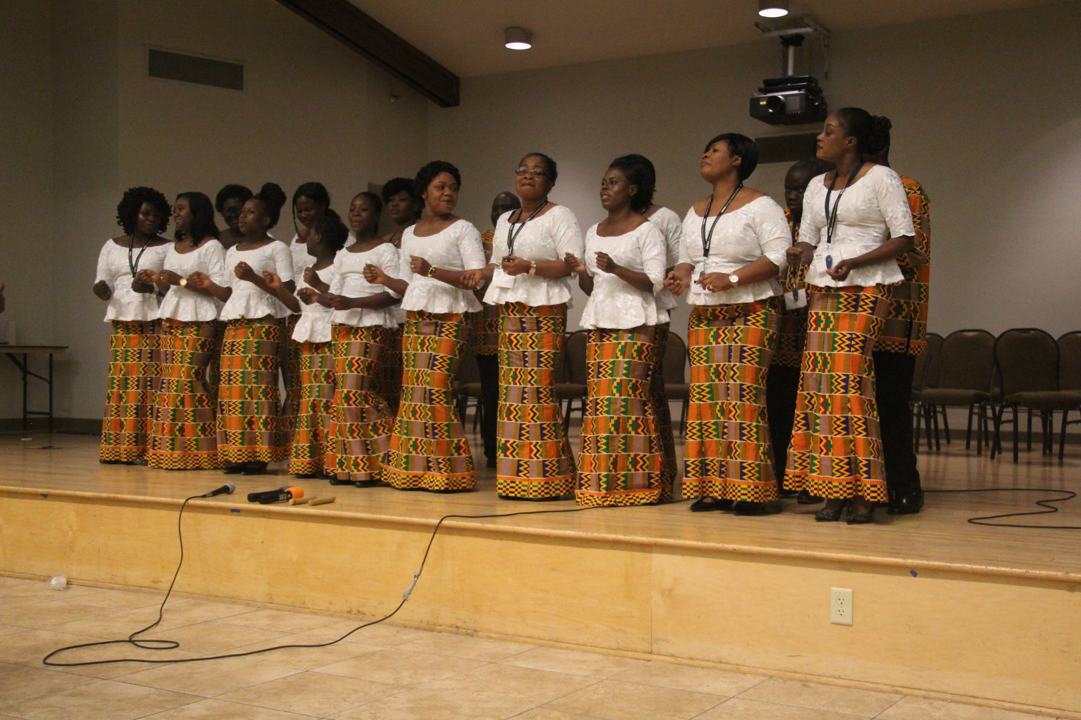

Slide 20
Houston

Slide 21
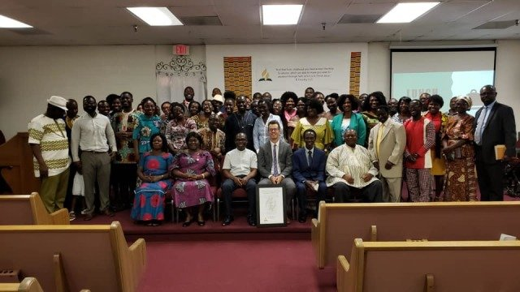
Riverside

