Slide 1
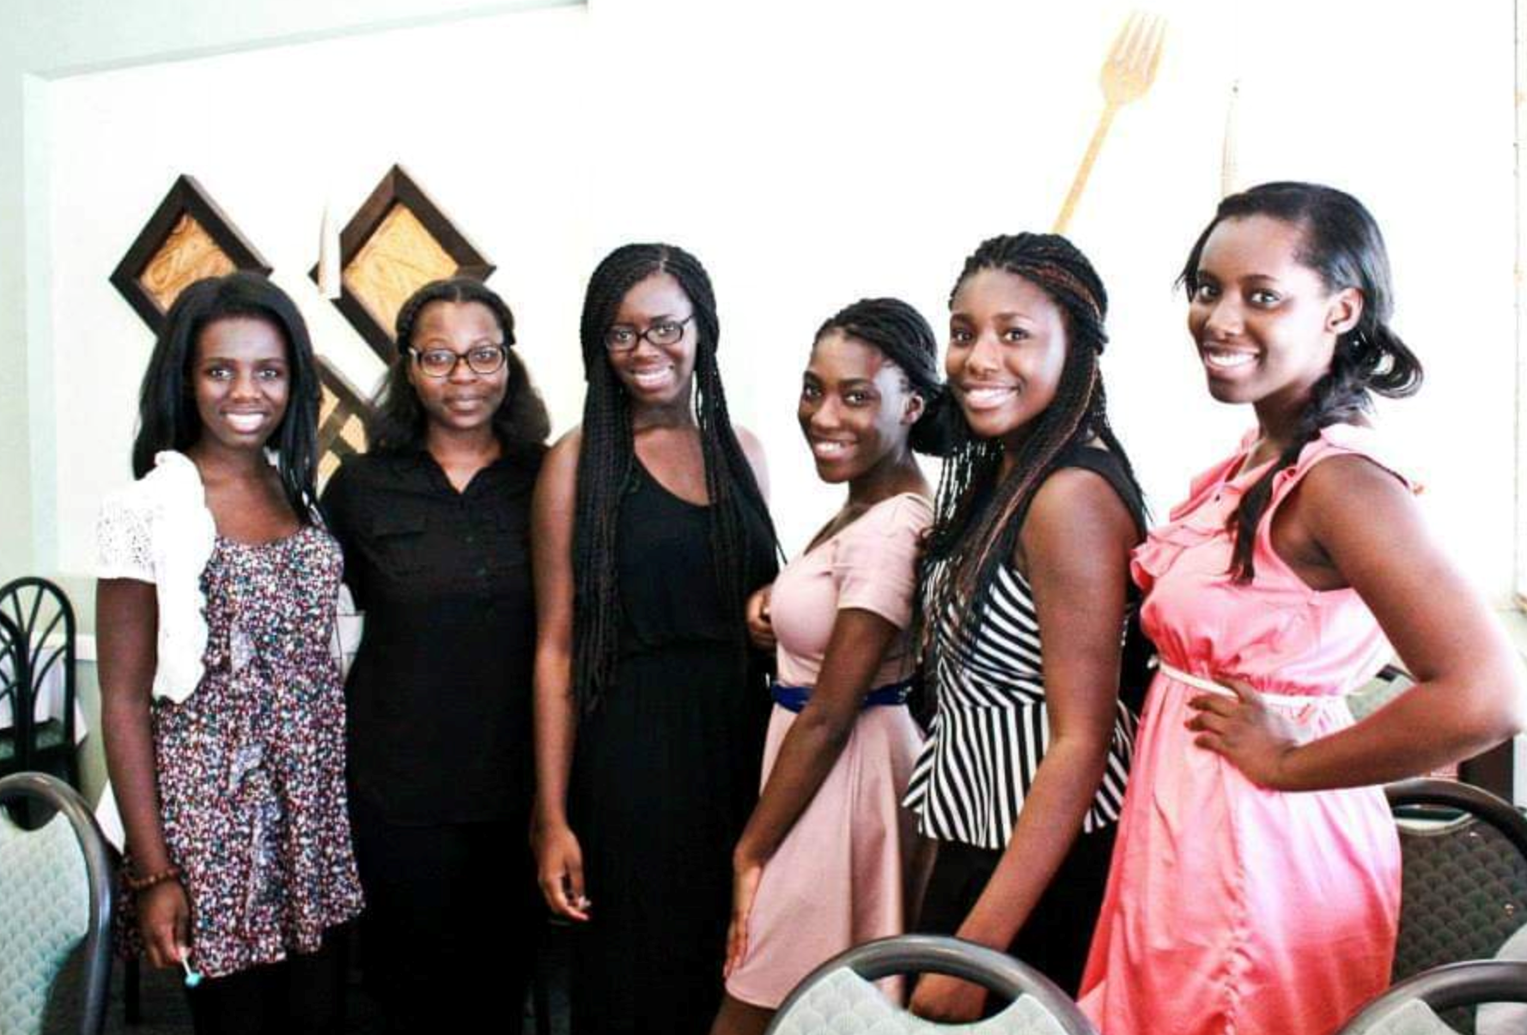
Sustaining The Spirit Of Revival
Abigail Nyantakyi, J.d.

Slide 2
Train up a child in the way he should go, And when he is old he will not depart from it –Proverbs 22:6.

Slide 3
“A Revival of true godliness among us is the greatest and most urgent of all our needs. To seek this should be our first work.” -Review and Herald.

Slide 4
Sustain-ability
Perfection
Apostasy
Revival
Reformation

Slide 5
Perfection
God created mankind in his own image; male and female he created them…(Genesis1:27). God saw all that he had made, and it was very good. (Genesis 1:31).
Hebrews 10:14 “For by one sacrifice he has made perfect forever those who are being made holy.”

Slide 6
Apostasy
Apostasy:
(1) an act of refusing to continue to follow, obey, or recognize a religious faith
(2) abandonment of a previous loyalty

Slide 7
Judah
Apostasy
Dinah → Joseph →Tamar

Slide 8
Revival
Revival Signifies:
(1) a renewal of spiritual life
(2) a quickening of the powers of mind and heart
(3) a resurrection from spiritual death. (Review and Herald)

Slide 9
Reformation
Reformation signifies:
(1) a reorganization
(2) a change in ideas and theories
(3) habits and practices.
“Reformation will not bring forth the good fruit of righteousness unless it is connected with the revival of the Spirit. Revival and reformation are to do their appointed work, and in doing this work they must blend.” (Review and Herald)
Judah → Revival/Reformation
Guarantor of Benjamin→ Blessings Genesis 49: 8-12

Slide 10
Judah vs. David
Judah
David
Had influence though not the eldest son.
Sold Joseph into Slavery.
Tamar
Was anointed king as the youngest son.
Tried to trick Uriah to sleep with Bathsheba to hide his sin before killing him.
Bathsheba

Slide 11
Genesis 29:35
She conceived again, and when she gave birth to a son she said, “This time I will praise the Lord.” So she named him Judah. Then she stopped having children.

Slide 12
Psalm 9:1
I will praise you, O Lord, with all my heart; I will tell of your wonders.

Slide 13
Praise
(1) Connects our hearts to the heart of God
(2) Opens us up to God’s Blessings

